Slide 1
Reinforcement Learning - Part 2
孫民＆技術處

Slide 3
軟實力
了解 Reinforcement Learning 的基本概念
理解進階Deep Q方法
理解 Policy Gradient的概念
硬實力
用 tensorflow 實作 policy-based 強化學習算法如 Policy Gradients
用AI瘋狂打電動
課程內容

Slide 4
各時段預計完成內容
9:30 - 10:30 | Deep Q-Learning
10:50 - 12:30 | Deep Q-Learning 實作
14:00 - 15:00 | Policy Gradient
15:20 - 17:00 | Challenge Time(option)
程式碼
實作課程環境建置
講師投影片
影片播放列表
課程投影片pdf
Notes:
縮起來

Slide 5
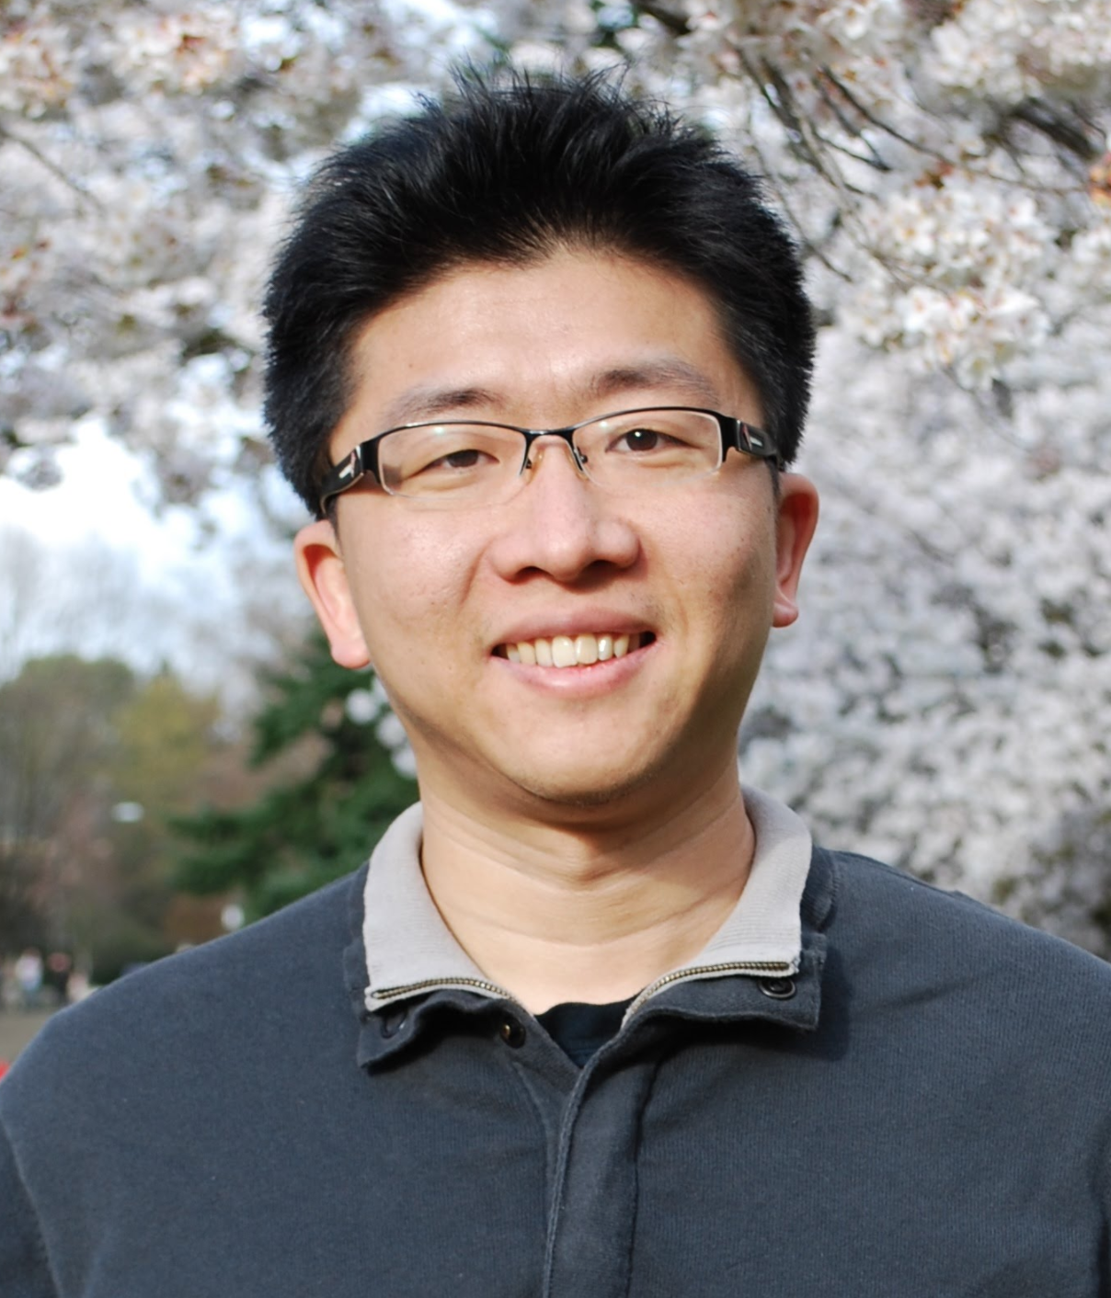
Q-Learning : Recap
暖身運動

Slide 6

Q-Learning 應用

Slide 7

Deep Q-Learning 概念
進化版 Q-Learning

Slide 8
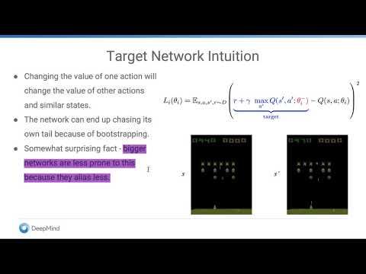
Deep Q-Learning-1

Slide 9

Deep Q-Learning-2

Slide 10
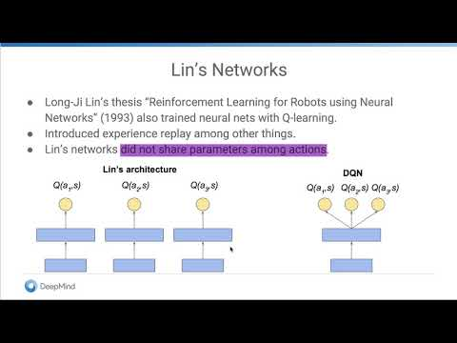
Deep Q-Learning-3

Slide 11
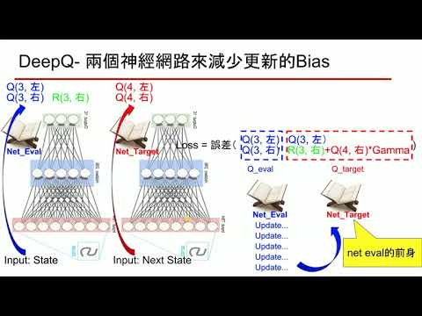
聽聽助教怎麼講

Slide 12
What’s Deep Q-Learning
利用神經網路代替以table紀錄Q值（已實作）
利用兩個神經網路來減少單一神經網路的傲慢與偏見
透過記憶庫存取過去經驗並回放重新挖掘價值
(key words: experience replay)

Slide 13


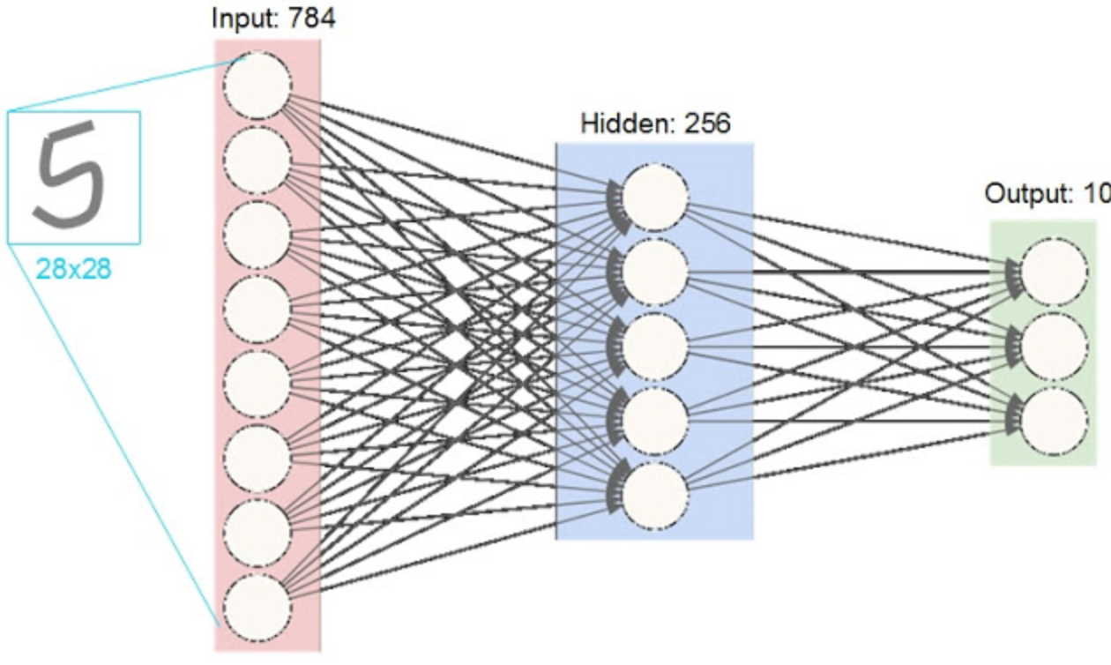
單一神經網路的弊端
Q(3, 左)
Q(4, 左)
Q(3, 右)
R(3, 右)
Q(4, 右)
Q(3, 左) Q(3, 左）
Loss = 誤差（ , )
Q(3, 右)
R(3, 右)+Q(4, 右)*Gamma
Q_eval
Q_target
一般我們將Q_target當作當下真實的Q值，因此用Q_target和Q_eval的誤差來更新神經網路，但在探索初期由於對環境的陌生，沒有人敢保證Q_target就是真實的Q值，如果做出了某些行為得到了好處，那就很容易接下來都一直出現這樣的行為而不探索其他的可能，最後被困在local maximum成為井底之蛙。
Input: State
Input: Next State

Slide 14
Deep Q-Learning 兩個神經網路來減少更新的Bias
Q(3, 左)
Q(4, 左)
Q(3, 右)
R(3, 右)
Q(4, 右)
用舊參數神經網路來監督新參數的神經網路，避免它自我感覺良好～
Q(3, 左) Q(3, 左）
Loss = 誤差（ , )
Q(3, 右)
Net_Eval
Net_Target
R(3, 右)+Q(4, 右)*Gamma
Q_eval
Q_target
Net_Eval
Net_Target
Update...
Update...
Update...
net eval的前身
Input: State
Update...
Input: State
Input: Next State
Update...

Slide 15


Deep Q-Learning 利用記憶庫重新回顧過去經驗
Q(3, 左)
Q(4, 左)
Q(3, 右)
R(3, 右)
Q(4, 右)
Memory
Net_Eval
Net_Target
(S, A, R, S_)
(S, A, R, S_)
(S, A, R, S_)
每一次更新都可以選取一個batch的資料做更新。
(S, A, R, S_)
(S, A, R, S_)
(S, A, R, S_)
.
.
.
.
.
(S, A, R, S_)
Input: State
Input: State
Input: Next State

Slide 16

搭建Deep Q-Learning
Net_Eval
Net_Target
Memory
將剛剛的概念用程式碼拼起來吧～

Slide 17
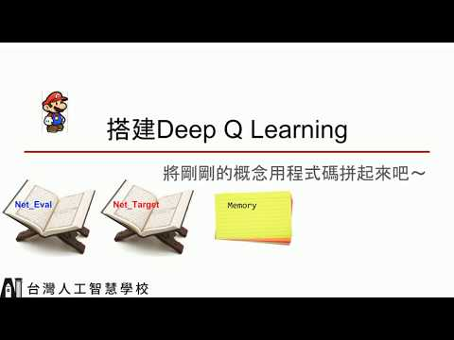
搭建Deep Q-Learning

Slide 18
Deep Q-Learning 實作- Class內的function
class DeepQLearning:
def __init__(
self,
n_actions, #動作的維度，例如上下左右就有四維
n_states, #用來描述狀態的維度，例如馬力歐在平面上就是二維
gamma = 0.9, #遠見程度
epsilon = 0.9, #保守程度，越大就越容易用Q值大小來採取行動；
learning_rate = 0.001 #神經網路的更新率
epsilon_increase = 0.01,
learning_rate = 0.001, #神經網路的更新率
memory_size = 50, #記憶庫的大小
batch_size = 32, #由於有記憶庫，更新時可以使用多筆資料
neuron_num = 10):
def write_memory(self, current_state, next_state, reward, action):
def build_network(self, scope):
def choose_action(self, current_state):
def learn(self, current_state, reward, next_state):
def model_save(self, model_name):
def model_restore(self, model_name):
Net_Eval
Net_Target
(1)
Memory
(2)
(3)
(4)
(5)
(6)

Slide 19
Deep Q-Learning 實作- 初始化- 1（給定變數）
class DeepQLearning:
def __init__():
self.n_actions = n_actions
self.n_states = n_states
self.gamma = gamma
self.epsilon_max = epsilon
self.epsilon_increase = epsilon_increase
self.epsilon = 0 if epsilon_increase is not None else epsilon
self.lr = learning_rate
self.batch_size = batch_size
self.memory_size = memory_size
self.memory_counter = 0
self.nueron_num = nueron_num
##### initialize memory
self.memory = np.zeros((self.memory_size, n_states * 2 + 2))
Net_Eval
Net_Target
Memory
(s, s_, r, a)
(s, s_, r, a)
(s, s_, r, a)
(s, s_, r, a)
要回放過去的經驗所需要的資訊就是current state, next state, reward和action，如此就可以算出memory在column方向所需要的維度了。

Slide 20
Deep Q-Learning 實作- 初始化-2（搭建神經網路）
class DeepQLearning:
def __init__():
tf.reset_default_graph() ## 重新 build graph 需要跑這行
self.sess = tf.Session() #宣告session
self.state_input = tf.placeholder(shape = [None, self.n_states],name =
'input',dtype = tf.float32)
self.q_target = tf.placeholder(shape = [None, self.n_actions],name =
'q_target',dtype = tf.float32)
with tf.variable_scope('Q_table'): #搭建神經網路
self.q_eval = self.build_network(self.nueron_num, Trainable = True,
scope = 'net_eval')
self.q_next = self.build_network(self.nueron_num, Trainable = False,
scope = 'net_target')
self.Qnet_eval_params=tf.get_collection(tf.GraphKeys.GLOBAL_VARIABLES, scope='Q_table/net_eval
self.Qnet_target_params=tf.get_collection(tf.GraphKeys.GLOBAL_VARIA
BLES, scope='Q_table/net_target')
Net_Eval
Net_Target
Memory

Slide 21
Deep Q-Learning 實作- 初始化-3（搭建神經網路）
class DeepQLearning:
def __init__():
self.replace_net_params = [tf.assign(old, new) for old, new in
zip(self.Qnet_target_params, self.Qnet_eval_params)]
self.loss = tf.reduce_mean(tf.squared_difference(self.q_target,
self.q_eval))
self.train = tf.train.RMSPropOptimizer(self.lr).minimize(self.loss,
var_list=self.Qnet_eval_params)
self.sess.run(tf.global_variables_initializer()) #將神經網路初始化
Net_Eval
Net_Target
net eval的前身
Memory

Slide 22
Deep Q-Learning 實作- 儲存與環境互動資訊
class DeepQLearning:
def __init__():
self.memory_counter = 0
self.memory = np.zeros((self.memory_size, n_states * 2 + 2))
def write_memory(self, current_state, next_state, reward, action):
env_info = np.concatenate([current_state, next_state, [reward], [action]])
save_index = self.memory_counter%self.memory_size
self.memory[save_index, :] = env_info
self.memory_counter+=1
if self.memory_counter%self.memory_size == 0:
self.memory_counter = self.memory_size
(1)
Net_Eval
Net_Target
Memory

Slide 23
Deep Q-Learning 實作-定義神經網路hidden layer
class DeepQLearning:
def __init__():
with tf.variable_scope('Q_table'):
self.q_eval = self.build_network(self.nueron_num, Trainable = True,
scope = 'net_eval')
self.q_next = self.build_network(self.nueron_num, Trainable = False,
scope = 'net_target')
def build_network(self, neuron_num, Trainable, scope):
with tf.variable_scope(scope):
init_w = tf.random_normal_initializer(0., 0.3)
init_b = tf.constant_initializer(0.1)
x_h1 = tf.layers.dense(inputs = self.state_input,units = neuron_num,
activation = tf.nn.tanh,kernel_initializer=init_w, bias_initializer=init_b,trainable=Trainable)
output = tf.layers.dense(inputs = x_h1,units = self.n_actions, kernel_initializer=init_w,bias_initializer=init_b,trainable=Trainable)
return output
Net_Eval
Net_Target
(2)
Memory

Slide 24
Deep Q-Learning 實作-定義選擇動作的方式
class DeepQLearning:
def choose_action(self, current_state):
if np.random.uniform() < self.epsilon: #利用epsilon控制冒險程度
#選擇產生估計Q值較大的行動
q_eval = self.sess.run(self.q_eval, feed_dict={self.state_input:
current_state[np.newaxis, :]})
self.action = np.argmax(q_eval)
else:
#採取隨機行動
self.action = np.random.randint(0, self.n_actions)
return self.action #輸出‘不同動作’對應的Q值
(3)
Net_Eval
Net_Target
看書（神經網路）選擇動作
不看書（神經網路）選擇動作
Memory

Slide 25
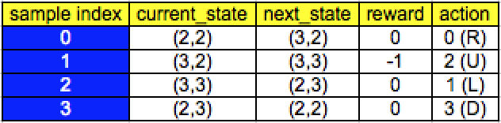
Deep Q-Learning 實作-定義學習方式-1
class DeepQLearning:
def __init__( ):
self.replace_net_params = [tf.assign(old, new) for old, new in
zip(self.Qnet_target_params, self.Qnet_eval_params)]
def learn(self, current_state, reward, next_state, update_params):
if update_params:
self.sess.run(self.replace_net_params)
if self.memory_counter > self.memory_size:
sample_index = np.random.choice(self.memory_size,
size=self.batch_size)
else:
sample_index = np.random.choice(self.memory_counter,
size=self.batch_size)
(4)
Net_Eval
Net_Target
Memory
Memory Table
設定一固定步數間隔用eval net的參數更新target net的參數
隨機產生batch_size數量的index之後用來抓取memory中的資料

Slide 26
Deep Q-Learning 實作-定義學習方式-2
class DeepQLearning:
def __init__( ):
def write_memory(self, current_state, next_state, reward, action):
env_info = np.concatenate([current_state, next_state, [reward], [action]])
def learn(self, current_state, reward, next_state, update_params):
past_experience = self.memory[sample_index, :]
current_state = past_experience[:, 0:self.n_states]
next_state = past_experience[:, self.n_states:self.n_states*2]
reward = past_experience[:, self.n_states*2]
action = past_experience[:, self.n_states*2+1].astype(int)
(1)
(4)
Net_Eval
Net_Target
Memory Table
Memory

Slide 27
Deep Q-Learning 實作-定義學習方式-3
class DeepQLearning:
def __init__( ):
with tf.variable_scope('Q_table'): #搭建神經網路
self.q_eval = self.build_network(self.nueron_num, Trainable = True,
scope = 'net_eval') #新神經網路
self.q_next = self.build_network(self.nueron_num, Trainable = False,
scope = 'net_target') #舊神經網路
def learn(self, current_state, reward, next_state, update_params):
index = np.arange(self.batch_size) # ex: [0, 1, 2, … 31]
q_eval = self.sess.run(self.q_eval, feed_dict={self.state_input:
current_state})
q_next = self.sess.run(self.q_next, feed_dict={self.state_input: next_state})
q_target = q_eval.copy()
q_target[index, action] = reward + self.gamma*np.max(q_next, axis=1)
_, self.cost = self.sess.run([self.train, self.loss], feed_dict={self.state_input:
current_state,self.q_target: q_target})
Net_Eval
Net_Target
(4)
Memory

Slide 28
Deep Q-Learning 實作-定義學習方式-3
class DeepQLearning:
def learn(self, current_state, reward, next_state, update_params):
index = np.arange(self.batch_size) # ex: [0, 1, 2, … 31]
q_eval = self.sess.run(self.q_eval, feed_dict={self.state_input:
current_state})
q_next = self.sess.run(self.q_next, feed_dict={self.state_input: next_state})
q_target = q_eval.copy()
q_target[index, action] = reward + self.gamma*np.max(q_next, axis=1)
_, self.cost = self.sess.run([self.train, self.loss], feed_dict={self.state_input:
current_state,self.q_target: q_target})
(4)
Net_Eval
Net_Target
Q(s, a) = R(s, a) + max(Q(s_, a))*Gamma
Batch 32
data0:
data1:
[[0.5, 0.3, -0.3, 1],
[0.2, 0.7, -0.5, -1],
[0.5, -0.9, 0.6, 0.2]]
[ 0,
( -1, )
1]
[[0.7, 0.2, -0.1, 0.3],
( [0.5, 0.1, -0.4, 1], )
[0.1, -0.8, 0.5, 0.9]]
Memory
=
+
*Gamma
data31:

Slide 29
Deep Q-Learning 實作-定義學習方式-4
class DeepQLearning:
def __init__():
epsilon = 0.9, #保守程度，越大就越容易用Q值大小來採取行動；
epsilon_increase = 0.01,#
def choose_action(self, current_state):
if np.random.uniform() < self.epsilon: #利用epsilon控制冒險程度
#選擇產生估計Q值較大的行動
q_eval = self.sess.run(self.q_eval, feed_dict={self.state_input:
current_state[np.newaxis, :]})
self.action = np.argmax(q_eval)
else:
#採取隨機行動
self.action = np.random.randint(0, self.n_actions)
return self.action #輸出‘不同動作’對應的Q值
def learn(self, current_state, reward, next_state, update_params):
# increasing epsilon
self.epsilon = self.epsilon + self.epsilon_increase if self.epsilon <
self.epsilon_max else self.epsilon_max
(1)
Net_Eval
Net_Target
Memory
(4)

Slide 30
Deep Q-Learning 實作-儲存和回復model參數
class DeepQLearning:
def __init__( ):
self.sess = tf.Session() #宣告session
def model_save(self, model_name):
saver = tf.train.Saver()
saver.save(self.sess, "saved_models/{}.ckpt".format(model_name))
def model_restore(self, model_name):
saver = tf.train.Saver()
saver.restore(self.sess, "saved_models/{}.ckpt".format(model_name))
(5)
(6)
Net_Eval
Net_Target
Memory

Slide 31
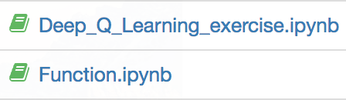
It’s Your Turn
class DeepQLearning:
def __init__():
def write_memory(self,??):
def build_network(self, scope):
def choose_action(self,??):
def learn(self,??):
def model_save(self, model_name):
def model_restore(self, model_name):
Net_Eval
Net_Target
請幫忙把class中function的內容放到對的位置，並填入各個funtion應該輸入的值
Memory

Slide 32
問題
在程式碼中已經幫大家把Agent 和環境互動的方式寫在Training的function中了，大家可以觀察看看哪裏有和Q Learning不一樣的地方？
Reward
Write Memory
利用Learn count讓Agent一開始不學習，進行瀟灑探索
利用Update count控制Net Target落後Net Eval的落後程度。
大家有時間的話可以調整Reward看看，例如直接用mountain car原始設定的Reward 跑跑看，感受一下Reward在引導RL達成目標上扮演多重要的角色～

Slide 33
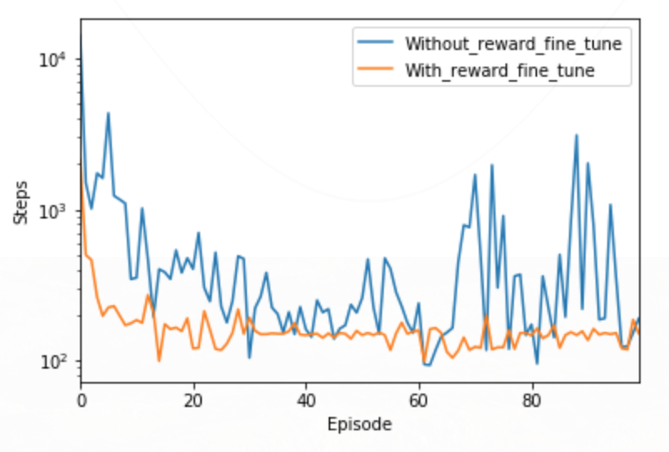
Mountain Car Traing Result- Deep Q
Steps越大代表每一回合將小車推上山丘的步數越多，因此用步數來評估agent是否有學到正確決策方法。

Slide 34
丟掉祕笈訓練反射動作成為練武奇材吧～
Policy Gradient 概念

Slide 35
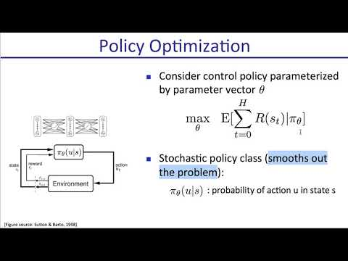
Policy Gradient

Slide 36
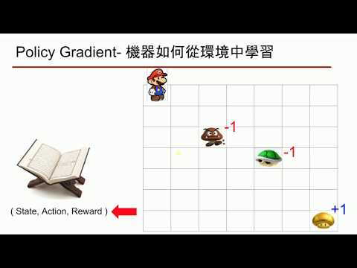
Policy Gradient - Simple Example

Slide 37



Policy Gradient - 機器如何從環境中學習
每次都還要記筆記然後查筆記太麻煩了
-1
-1
+1
( State, Action, Reward )

Slide 38
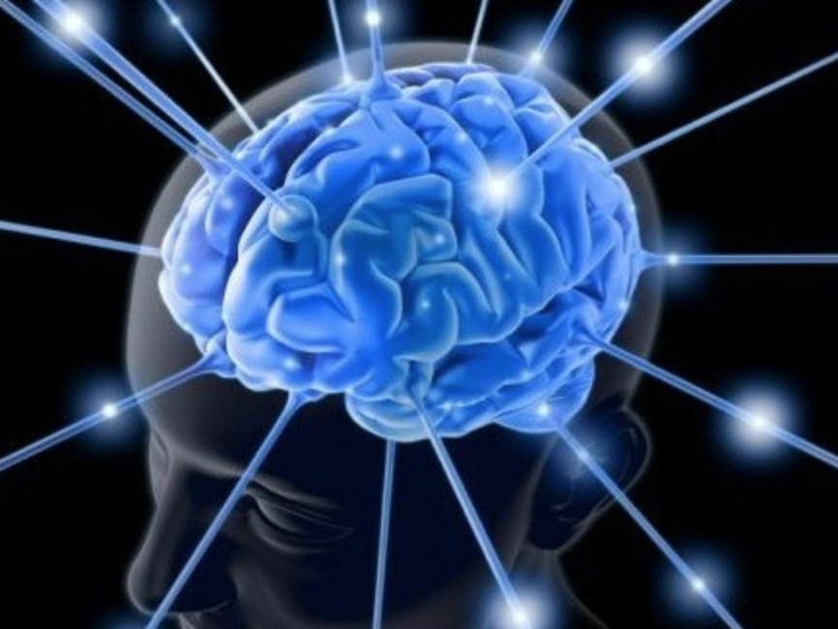
Policy Gradient - 機器如何從環境中學習
直接訓練自己的反射神經～
Output:
Action Proba
-1
-1
Input: State
+1
( State, Action, Reward )

Slide 39
Policy Gradient - 機器如何產生反射動作
利用機率抽樣得到下個動作，雖然機率大的動作較容易被抽取到，但還是有很大的隨機性，因此不需要epsilon控制隨機性
Output: Action Proba
R:0.5, L:0.2, U:0.1, D:0.2
-1
-1
Input: State
+1
( State, Action, Reward )

Slide 40
Policy Gradient - 機器如何學習正確反射動作
State, Output Action Proba, Reward
(U,D,L,R)
( [0,0], [0.2,0.5,0.1,0.2], 0 )
( [0,1], [0.4,0.4,0.1,0.1], 0 )
( [0,2], [0.3,0.2,0.2,0.3], 0 )
…….
-1
( [1,2], [0.2,0.2,0.3,0.2], -1)
…….
( [5,6], [0.3,0.2,0.1,0.4], 1)
-1
State, Real Action, Reward
(U,D,L,R)
( [0,0], [0,1,0,0], 0 )
( [0,1], [0,1,0,0], 0 )
( [0,2], [0,1,0,0], 0 )
…….
+1
( [1,2], [0,0,0,1], -1)
…….
( [5,6], [0,0,0,1], 1)

Slide 41
Policy Gradient - 機器如何學習正確反射動作
用實際的行動來糾正反射神經的輸出
誤差(反射神經網路輸出, 實際行動）
Real Action
Output Action Proba
Cross Entropy(Output Action Proba, Real Action)
( [0,0], [0,1,0,0], 0 )
( [0,0], [0.2,0.5,0.1,0.2], 0 )
( [0,1], [0,1,0,0], 0 )
( [0,1], [0.4,0.4,0.1,0.1], 0 )
( [0,2], [0,1,0,0], 0 )
( [0,2], [0.3,0.2,0.2,0.3], 0 )
…….
…….
( [1,2], [0,0,0,1], -1)
( [1,2], [0.2,0.2,0.3,0.2], -1)
反糾正反射神經輸出
…….
…….
( [5,6], [0,0,0,1], 1)
( [5,6], [0.3,0.2,0.1,0.4], 1)
糾正反射神經輸出
回顧
Supervised Learning:
用Label來糾正神經網路的輸出
誤差(神經網路輸出, Label）
Cross Entropy(神經網路輸出, Label)

Slide 42
Policy Gradient - 機器如何學習正確反射動作
用實際的行動來糾正反射神經的輸出
誤差(反射神經網路輸出, 實際行動）
Real Action
Output Action Proba
Cross Entropy(Output Action Proba, Real Action)
( [0,0], [0,1,0,0], 0 )
( [0,0], [0.2,0.5,0.1,0.2], 0 )
( [0,1], [0,1,0,0], 0 )
( [0,1], [0.4,0.4,0.1,0.1], 0 )
( [0,2], [0,1,0,0], 0 )
( [0,2], [0.3,0.2,0.2,0.3], 0 )
…….
…….
-Cross Entropy(
[0.2,0.2,0.3,0.2], [0,0,0,1])
( [1,2], [0,0,0,1], -1)
( [1,2], [0.2,0.2,0.3,0.2], -1)
…….
…….
( [5,6], [0,0,0,1], 1)
( [5,6], [0.3,0.2,0.1,0.4], 1)
Cross Entropy(
[0.3,0.2,0.1,0.4], [0,0,0,1])
回顧
Supervised Learning:
用Label來糾正神經網路的輸出
誤差(神經網路輸出, Label）
Cross Entropy(神經網路輸出, Label)

Slide 43
Policy Gradient - 機器如何學習正確反射動作
用實際的行動來糾正反射神經的輸出
誤差(反射神經網路輸出, 實際行動）
Real Action
Output Action Proba
R*Cross Entropy(Output Action Proba, Real Action)
( [0,0], [0,1,0,0], 0 )
( [0,0], [0.2,0.5,0.1,0.2], 0 )
( [0,1], [0,1,0,0], 0 )
( [0,1], [0.4,0.4,0.1,0.1], 0 )
( [0,2], [0,1,0,0], 0 )
( [0,2], [0.3,0.2,0.2,0.3], 0 )
…….
…….
Reward*Cross Entropy(
[0.2,0.2,0.3,0.2], [0,0,0,1])
( [1,2], [0,0,0,1], -1)
( [1,2], [0.2,0.2,0.3,0.2], -1)
…….
…….
( [5,6], [0,0,0,1], 1)
( [5,6], [0.3,0.2,0.1,0.4], 1)
Reward*Cross Entropy(
[0.3,0.2,0.1,0.4], [0,0,0,1])
回顧
Supervised Learning:
用Label來糾正神經網路的輸出
誤差(神經網路輸出, Label）
Cross Entropy(神經網路輸出, Label)

Slide 44
Policy Gradient- 機器如何學習正確反射動作
用實際的行動來糾正反射神經的輸出
誤差(反射神經網路輸出, 實際行動）
Real Action
Output Action Proba
R*Cross Entropy(Output Action Proba, Real Action)
( [0,0], [0,1,0,0], 0 )
( [0,0], [0.2,0.5,0.1,0.2], 0 )
問題：前三個動作因為沒有得到reward所以誤差為0，因此不需要反向傳更新神經網路的參數，這樣代表的意思就是這樣的行為沒有對或錯，這樣合理嗎？
( [0,1], [0,1,0,0], 0 )
( [0,1], [0.4,0.4,0.1,0.1], 0 )
( [0,2], [0,1,0,0], 0 )
( [0,2], [0.3,0.2,0.2,0.3], 0 )
…….
…….
-1*Cross Entropy(
[0.2,0.2,0.3,0.2], [0,0,0,1])
( [1,2], [0,0,0,1], -1)
( [1,2], [0.2,0.2,0.3,0.2], -1)
…….
…….
( [5,6], [0,0,0,1], 1)
( [5,6], [0.3,0.2,0.1,0.4], 1)
1*Reward*Cross Entropy(
[0.3,0.2,0.1,0.4], [0,0,0,1])
回顧
Supervised Learning:
用Label來糾正神經網路的輸出
誤差(神經網路輸出, Label）
Cross Entropy(神經網路輸出, Label)

Slide 45
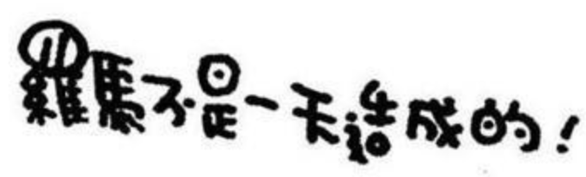
Policy Gradient- 機器如何學習正確反射動作
用實際的行動來糾正反射神經的輸出
誤差(反射神經網路輸出, 實際行動）
Real Action
Output Action Proba
R*Cross Entropy(Output Action Proba, Real Action)
( [0,0], [0,1,0,0], 0 )
( [0,0], [0.2,0.5,0.1,0.2], 0 )
問題：前三個動作因為沒有得到reward所以誤差為0，因此不需要反向傳更新神經網路的參數，這樣代表的意思就是這樣的行為沒有對或錯，這樣合理嗎？
( [0,1], [0,1,0,0], 0 )
( [0,1], [0.4,0.4,0.1,0.1], 0 )
( [0,2], [0,1,0,0], 0 )
( [0,2], [0.3,0.2,0.2,0.3], 0 )
…….
…….
-1*Cross Entropy(
[0.2,0.2,0.3,0.2], [0,0,0,1]))
( [1,2], [0,0,0,1], -1)
( [1,2], [0.2,0.2,0.3,0.2], -1)
…….
…….
( [5,6], [0,0,0,1], 1)
( [5,6], [0.3,0.2,0.1,0.4], 1)
1*Reward*Cross Entropy(
[0.3,0.2,0.1,0.4], [0,0,0,1])
太短視近利

Slide 46
Policy Gradient- 機器如何學習正確反射動作
用實際的行動來糾正反射神經的輸出
誤差(反射神經網路輸出, 實際行動）
Real Action
Output Action Proba
Vn*Cross Entropy(Output Action Proba, Real Action)
( [0,0], [0,1,0,0], 0 )
( [0,0], [0.2,0.5,0.1,0.2], 0 )
V1 = Reward + gamma*V2
( [0,1], [0,1,0,0], 0 )
( [0,1], [0.4,0.4,0.1,0.1], 0 )
V2 = Reward + gamma*V3
( [0,2], [0,1,0,0], 0 )
( [0,2], [0.3,0.2,0.2,0.3], 0 )
V3 = Reward + gamma*V4
…….
…….
…….
( [1,2], [0,0,0,1], -1)
( [1,2], [0.2,0.2,0.3,0.2], -1)
Vk = Reward + gamma*Vk+1
…….
…….
…….
( [5,6], [0,0,0,1], 1)
( [5,6], [0.3,0.2,0.1,0.4], 1)
Vn = Reward
透過V代替原本的reward就可以考慮到做誤差的更新修正就可以將reward反向傳到前面的狀態，也就是第一步的V可以考慮到之後任何每一步的reward了～

Slide 47
Policy Gradient 與 環境
步驟拆解：（回合更新制）
For 回合 in range(N):
利用神經網路產生的行動機率探索環境
記錄回合內所有過去的軌跡
回合結束時，利用這回合所有紀錄更新神經網路參數。
刪除這回合紀錄，結束這回合～
回合一
-1
-1
回合二
+1
回合三

Slide 48
搭建Policy Gradient
Memory
將剛剛的概念用程式碼拼起來

Slide 49
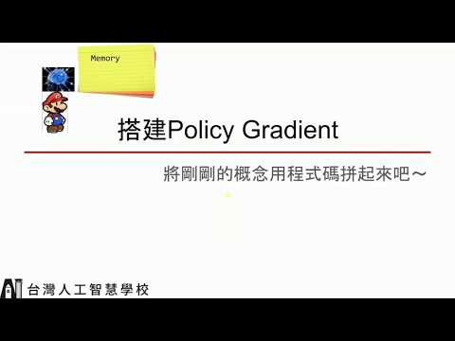
Policy Gradient 實踐

Slide 50
Policy Gradient 實作- Class內的function
class Policy_Gradient:
def __init__(self,
n_actions,
n_states, gamma = 0.9, #遠見程度
learning_rate = 0.001, #神經網路的更新率):
def write_memory(self, current_state, reward, action):
def choose_action(self, current_state):
def build_network(self, neuron_num, Trainable, scope):
def learn(self):
def calculate_Vt(self, reward):
def model_save(self, model_name):
def model_restore(self, model_name):
(1)
(2)
(3)
(4)
Memory
(5)
(6)
(7)

Slide 51
Policy Gradient 實作- 初始化- 1（給定變數）
class Policy_Gradient:
def __init__():
self.n_actions = n_actions
self.n_states = n_states
self.gamma = gamma
self.lr = learning_rate
##### initialize memory
self.past_state, self.past_action, self.past_reward = [], [], []
#####one hot space to save action
self.action_one_hot = np.zeros(self.n_actions, dtype=np.int32)
Memory

Slide 52
Policy Gradient 實作- 初始化- 2（搭建神經網路）
act_proba
class Policy_Gradient:
def __init__():
tf.reset_default_graph() #重新 build graph 需要跑這行
self.sess = tf.Session() #宣告session
self.state_input = tf.placeholder(shape = [None, self.n_states],
name = 'state_input',dtype = tf.float32) #state input
self.real_action = tf.placeholder(shape = [None, self.n_actions],
name = 'real_action',dtype = tf.float32) #real action和神經網路輸出算loss
self.Vt = tf.placeholder(shape= [None, ],name="Vt",dtype = tf.float32)
with tf.variable_scope('Actor'):
self.act_proba = self.build_network(self.nueron_num, Trainable
= True, scope = 'net_eval')
self.Actor_eval_params = tf.get_collection(tf.GraphKeys.GLOBAL_VARIABLES, scope='Actor/net_eval')
Input: State, real_action, Vt
Memory

Slide 53
Policy Gradient 實作- 初始化- 3（搭建神經網路）
loss(act_proba, real_action)*Vt
class Policy_Gradient:
def __init__():
self.cross_entropy = tf.reduce_sum(-tf.log(self.act_proba)*self.real_action,
axis=1)
self.loss = tf.reduce_sum(self.cross_entropy*self.Vt)
self.train = tf.train.RMSPropOptimizer(self.lr).minimize(self.loss,
var_list=self.Actor_eval_params)
self.sess.run(tf.global_variables_initializer())
Input: State, real_action, Vt
Memory

Slide 54
Policy Gradient 實作- 儲存與環境互動資訊
class Policy_Gradient:
def __init__():
self.action_one_hot = np.zeros(self.n_actions, dtype=np.int32)
self.past_state, self.past_action, self.past_reward = [], [], []
def write_memory(self, current_state, reward, action):
action_one_hot = self.action_one_hot.copy()
action_one_hot[action] = 1
self.past_state.append(current_state)
self.past_action.append(action_one_hot)
self.past_reward.append(reward)
(1)
用list儲存與環境互動資訊是因為要將本回合所有的資訊都存起來在回合結束後算出loss做update。
Memory
Note
將上、下、左、右 分別對應到action為 0、1、2、3轉換為one_hot_encoding：
action_one_hot = [ 0, 0, 0, 0 ]
action=1
action_one_hot[action] = 1 ⇒
action_one_hot = [ 0, 1, 0, 0 ]

Slide 55
Policy Gradient 實作- 定義選擇動作的方式
class Policy_Gradient:
def __init__():
self.state_input = tf.placeholder(shape = [None, self.n_states],
name = 'state_input',dtype = tf.float32) #state input
def choose_action(self, current_state):
act_proba = self.sess.run(self.act_proba, feed_dict={self.state_input:
current_state[np.newaxis, :]})
self.action = np.random.choice(range(act_proba.shape[1]),
p=act_proba.ravel())
return self.action
(2)
Memory
Note
將上、下、左、右 分別對應到action為 0、1、2、3。如果act_proba為[ 0.2, 0.4, 0.1, 0.3 ]，經由上面np.random.choice抽樣得到0的機率為20%、1為40%...依此類推。因為這樣的動作選取方式在探索初期已經具有很大的隨機性，因此不用像deep Q一樣利用epsilon控制隨機程度。探索後期act_proba如果有收斂也會變成某個動作機率特別大，其他特別小，例如[0.99, 0.003, 0.003, 0.003]。這樣和之前deep Q一開始給定很小的epsilon增加探索程度，然後慢慢增大epsilon有一樣的效果。

Slide 56
Policy Gradient 實作-定義神經網路的hidden Layer
class Policy_Gradient:
def __init__():
with tf.variable_scope('Actor'):
self.act_proba = self.build_network(self.nueron_num, Trainable =
True,
scope = 'net_eval')
def build_network(self, neuron_num, Trainable, scope):
with tf.variable_scope(scope):
init_w = tf.random_normal_initializer(0., 0.3)
init_b = tf.constant_initializer(0.1)
x_h1 = tf.layers.dense(inputs = self.state_input, units = neuron_num, activation = tf.nn.tanh, kernel_initializer=init_w, bias_initializer=init_b, trainable=Trainable)
output = tf.layers.dense(inputs = x_h1, units = self.n_actions,
activation = tf.nn.softmax, kernel_initializer=init_w,
bias_initializer=init_b, trainable=Trainable)
return output
(3)
Memory

Slide 57
Policy Gradient 實作- 定義學習方式
class Policy_Gradient:
def __init__():
self.state_input = tf.placeholder(shape = [None, self.n_states],
name = 'state_input',dtype = tf.float32) #state input
self.real_action = tf.placeholder(shape = [None, self.n_actions],
name = 'real_action',dtype = tf.float32) #real action input
self.Vt = tf.placeholder(shape= [None, ],name="Vt",dtype = tf.float32)
def learn(self):
Vt = self.calculate_Vt(self.past_reward)
self.sess.run(self.train,
feed_dict={self.state_input:np.vstack(self.past_state),
self.real_action: np.array(self.past_action),
self.Vt: np.array(Vt) })
#更新完後將記憶庫清空
self.past_state, self.past_action, self.past_reward = [], [], []
(4)
Memory
在前面概念有提到我們是利用cross_entropy(action_proba, real_action)*Vt得到Loss來更新神經網路

Slide 58
Policy Gradient 實作- 定義計算Vt的方式
class Policy_Gradient:
def learn(self):
Vt = self.calculate_Vt(self.past_reward)
def calculate_Vt(self, reward):
Vt = np.zeros_like(reward, dtype=np.float64)
Vt_temp = 0
for t in reversed(range(0, len(reward))):
Vt_temp = reward[t] + Vt_temp * self.gamma
Vt[t] = Vt_temp
# 將Vt做normalize
Vt -= np.mean(Vt)
Vt /= np.std(Vt)
return Vt
(4)
(5)
Memory
V1 = Reward + gamma*V2
V2 = Reward + gamma*V3
V3 = Reward + gamma*V4
…….
Vk = Reward + gamma*Vk+1
…….
Vn = Reward

Slide 59
Policy Gradient 實作- 儲存和回復model參數
class Policy_Gradient:
def __init__( ):
self.sess = tf.Session() #宣告session
def model_save(self, model_name):
saver = tf.train.Saver()
saver.save(self.sess, "saved_models/{}.ckpt".format(model_name))
def model_restore(self, model_name):
saver = tf.train.Saver()
saver.restore(self.sess, "saved_models/{}.ckpt".format(model_name))
(6)
(7)
Memory

Slide 60
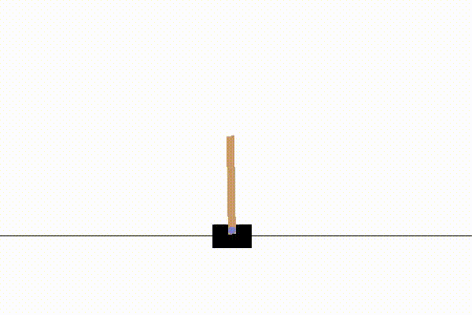
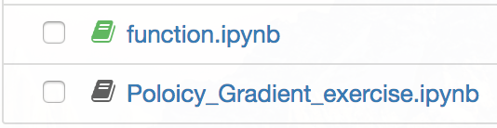
It’s Your Turn
class Policy_Gradient:
def __init__
def write_memory(self, ??):
def choose_action(self, ??):
def build_network(self, neuron_num, Trainable, scope):
def learn(self):
def calculate_Vt(self):
def model_save(self, model_name):
def model_restore(self, model_name):
該如何找到方法把桿子立起來呢？
請幫忙把class中function的內容放到對的位置，並填入各個funtion應該輸入的值
Memory

Slide 61
問題
在程式碼中已經幫大家把Agent 和環境互動的方式寫在Training的function中了，大家可以觀察看看哪裏有和Deep Q-Learning不一樣的地方？
提示：回合更新制和單步更新制的差別
用policy gradient玩mountain car，運氣好的人或電腦好一點的人可能不會有問題，但是如果前幾回合推了十萬步才將小車推上去，不就代表要一次將十萬步的資訊丟到神經網路去更新嗎？這是回合更新制的缺點，想想看該怎麼解決呢？
可能解法ㄧ：Batch Update with Generator
可能解法二：自己設定Maximum Step強迫結束遊戲

Slide 62
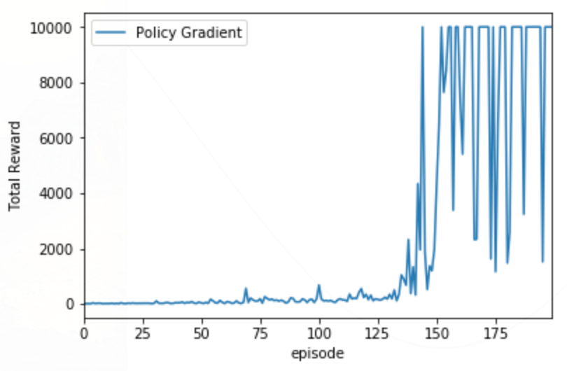
Cartpole Training Result- Policy Gradient

Slide 63
Policy Gradient V.S. Deep Q-Learning

Slide 64
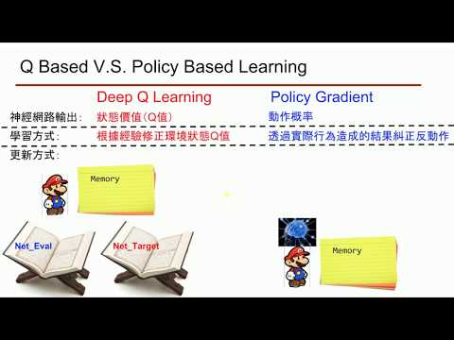
What's the difference ?

Slide 65
Q Based V.S. Policy Based Learning
Deep Q-Learning
Policy Gradient
神經網路輸出：
動作概率
狀態價值（Q值）
學習方式：
根據經驗修正環境狀態Q值
透過實際行為造成的結果糾正動作
更新方式：
單步更新(抽取Batch in Memory)
回合更新(整回合資訊）
Memory
Value Based Model
Policy Based Model
Net_Eval
Net_Target
Memory

Slide 66
Q Based V.S. Policy Based Learning
Deep Q-Learning
Policy Gradient
Pros：
及時修正對環境的認知
藉由輸出概率自行調整隨機探索程度
可回放過去經驗
可以處理連續值動作的問題
Cons：
回合更新學習速度慢，有可能因為一直沒有到達終點以至於被困住...
只能處理Discrete動作的問題
當好動作較少時，隨機抽樣過去經驗學習效率低
Q值的評估對policy是否有直接幫助
Value Based Model
Policy Based Model

Slide 67


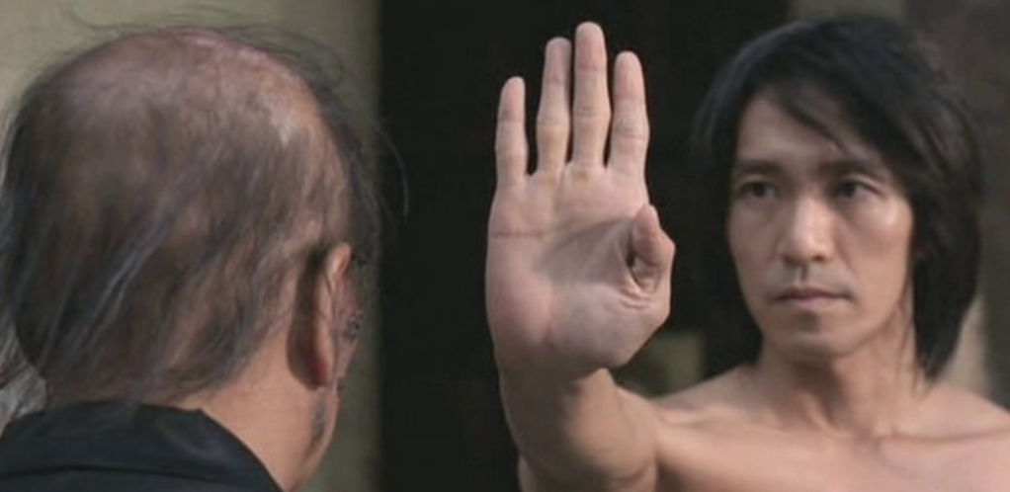
下回預告
不只要訓練反射動作，也要編寫一本武功祕笈才能真的練就如來神掌～
Actor
Critic
DDPG

Slide 68
挑戰時間
手癢了嗎？ It's coding time !

Slide 69
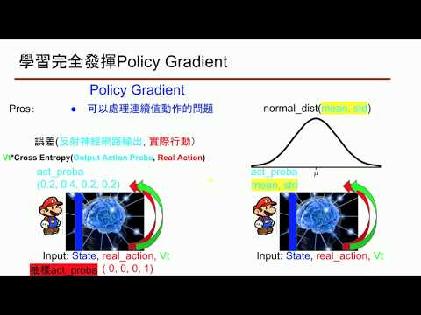
Policy Gradient實戰

Slide 70
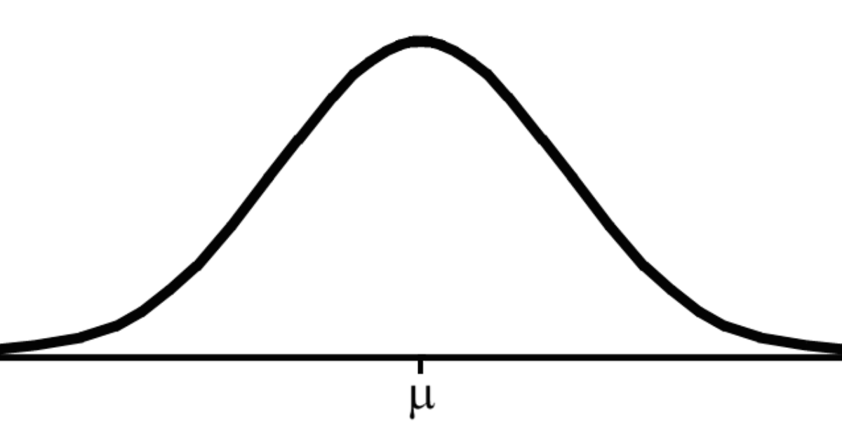
學習完全發揮Policy Gradient
Policy Gradient
Pros：
normal_dist(mean, std)
可以處理連續值動作的問題
誤差(反射神經網路輸出, 實際行動）
Vt*Cross Entropy(Output Action Proba, Real Action)
act_proba
(0.2, 0.4, 0.2, 0.2)
act_proba
mean, std
Input: State, real_action, Vt
( 0, 0, 0, 1)
Input: State, real_action, Vt
抽樣act_proba
抽樣act_proba

Slide 71
學習完全發揮Policy Gradient
Policy Gradient
Pros：
normal_dist(mean, std)
可以處理連續值動作的問題
誤差(反射神經網路輸出, 實際行動）
Vt*Cross Entropy(Output Action Proba, Real Action)
機率
real_action
act_proba
p
-log( )
mean, std
act_proba=normal_dist(mean, std)
Input: State, real_action, Vt
Cross Entropy = -log(act_proba(real_action))
抽樣act_proba

Slide 72
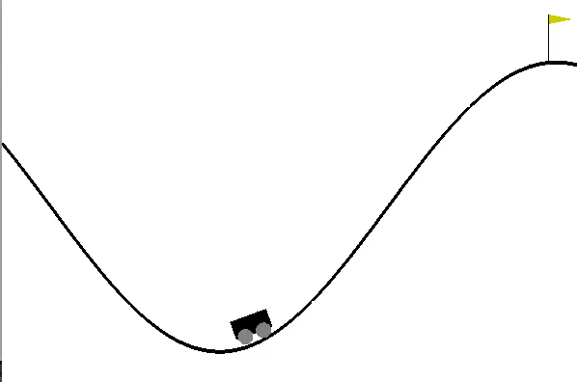
Continuous Mountain Car Exercise- Policy Gradient
提示ㄧ：n_actions =1
Cross Entropy = -log(act_proba(real_action))
提示二：改動def build_network, choose_action和 計算cross_entropy
normal_dist(mean, std)
act_proba=
提示三：加上def generator
Discrete | 正向力 | 不出力 | 負向力
Continuous | force: 介於-1到1之間
act_proba
mean, std
Input: State, real_action, Vt
抽樣act_proba

Slide 73
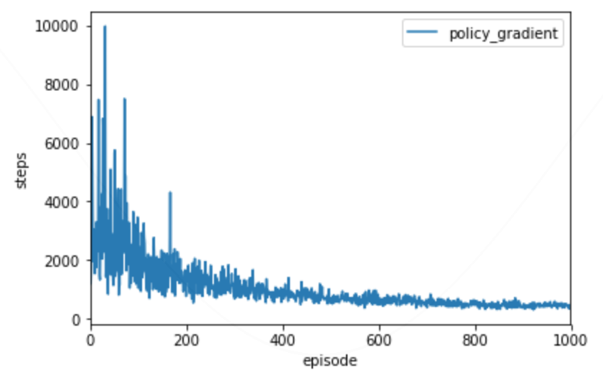
Training Result- Continuous Mountain Car

Slide 74

學習改善Q Based Model
Deep Q-Learning
無解
Cons：
只能處理Discrete動作的問題
當好動作較少時，隨機抽樣過去經驗學習效率低
key word:
Prioritized Experience
Q值的評估對policy是否有直接幫助
key word:
Dueling DQN
Value Based Model
參考連結：https://zhuanlan.zhihu.com/p/21547911

Slide 75
大補帖

Slide 76
Resources
讓大師David Silver教你完整的強化學習
台大 MLDS 課程
李宏毅 - Deep Reinforcement Learning (2018/6月份)
Deep Reinforcement Learning UC Berkeley 2017

